Slide 1

UNIBO
STUDY ABROAD OPPORTUNITIES
Focus on extra UE mobility

Slide 2
#5 REASONS TO DECIDE TO STUDY ABROAD
#1 DEEPEN AND IMPROVE YOUR LEVEL IN A FOREIGN LANGUAGE DIVING IN CULTURE AND HABITS OF THE HOSTING COUNTRY
#2 EXPERIENCE NEW AND DIFFERENT UNIVERSITY SYSTEMS AND LEARNING METHODS
#3 BECOME MORE AUTONOMOUS AND KNOW HOW TO GET BY IN ALL SITUATIONS
#4 MEET PERSONS FROM ALL OVER THE WORLD AND OPEN YOUR MIND TOWARDS DIFFERENT CULTURES
#5 ENRICH YOUR CV WITH AN EXPERIENCE WHICH WILL BE PARTICULARLY APPRECIATED BY FUTURE EMPLOYERS

Slide 3

Why?
TO TRAVEL TO NEW PLACES
TO IMPROVE SELF-AWARENESS
TO BECOME MORE INDIPENDENT

Slide 4
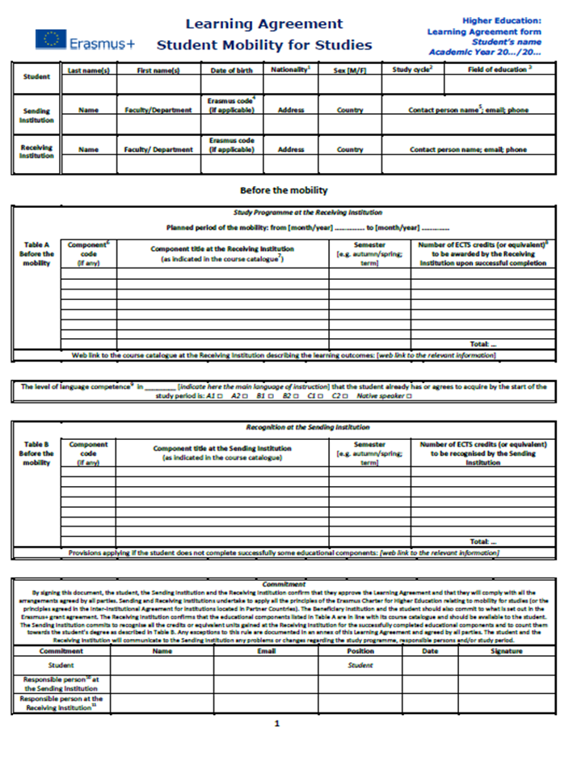


What does ‘study abroad’ mean?
STUDY attend classes and taking exams
RECOGNITION
RESEARCH for your
thesis

Slide 5
TWO STUDY ABROAD FLAGSHIP PROGRAMMES
ERASMUS+ STUDY
a mobility program promoted by the EU which allows you to spend part of your studies at partner universities in other countries in the European Union and beyond
OVERSEAS
a UniBo funded program which offers you an opportunity to study in Asia, Europe, Africa, America and Oceania

Slide 6
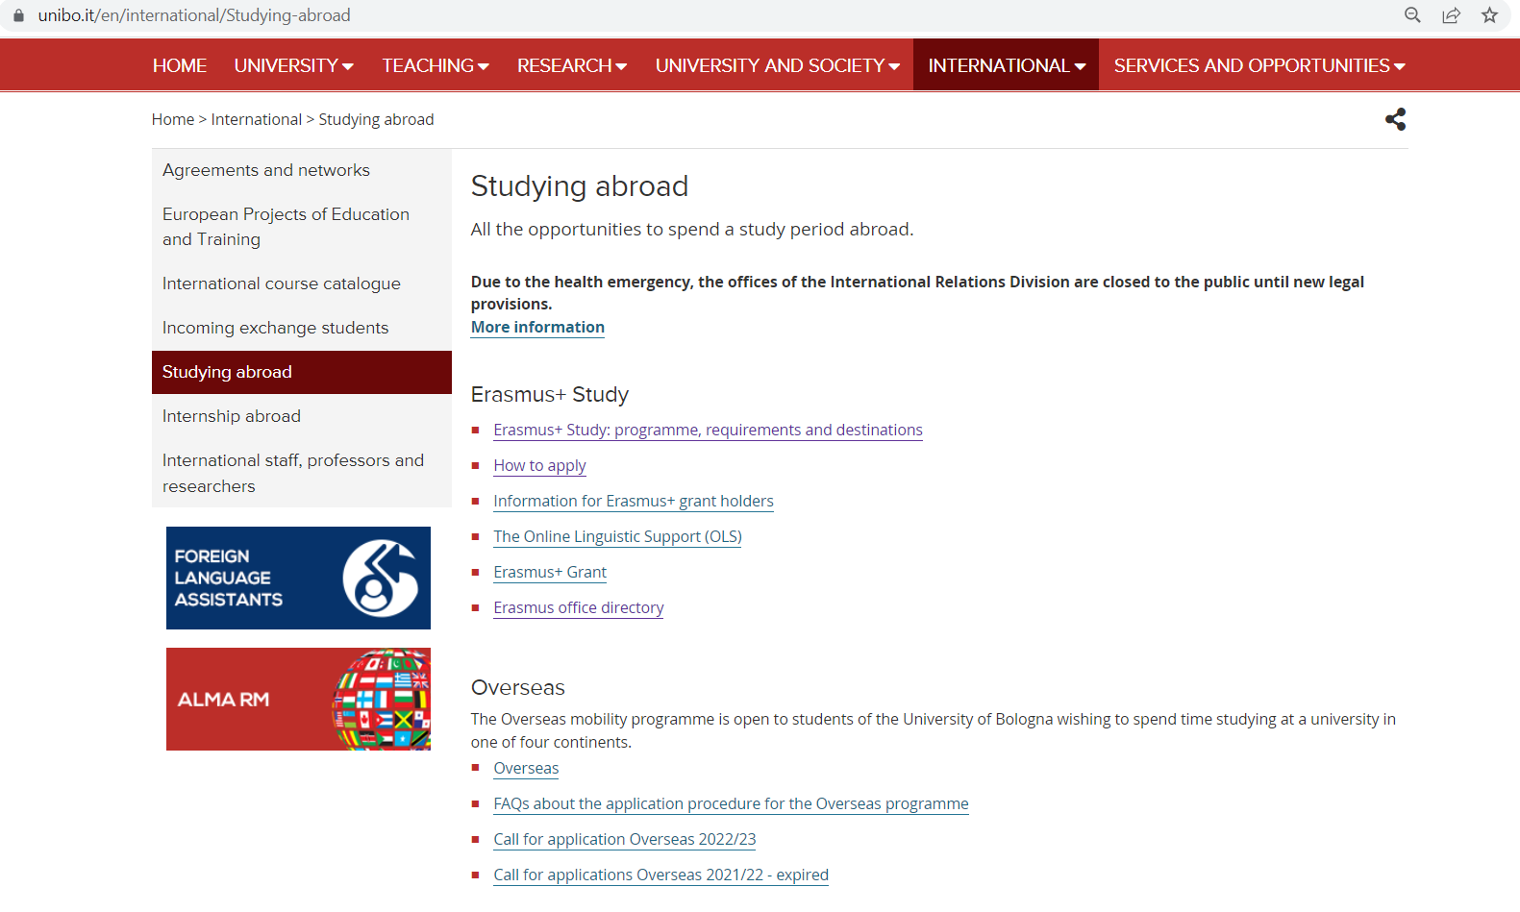
Finding information
https://www.unibo.it/en/international/Studying-abroad

Slide 7
ERASMUS+
A MOBILITY PROGRAM LAUNCHED IN THE EUROPEAN UNION IN 1987
EUROPEAN ACTION SCHEME FOR THE MOBILITY OF UNIVERSITY STUDENTS
What is Erasmus+?
PART OF YOUR ACADEMIC CARRER (2-12 MONTHS) IN ANOTHER PARTNER UNIVERSITY
EU GRANT TOWARDS THE ADDITIONAL EXPENSES ASSOCIATED WITH LIVING ABROAD

Slide 8


Why should you go in Erasmus with UniBo?
IN 2019, THE FIRST UNIVERSITY IN EUROPE FOR BOTH INCOMING (STUDENTS COMING TO UNIBO) AND OUTGOING MOBILITY (UNIBO STUDENTS GOING ABROAD)
MORE THAN 2600 BILATERAL AGREEMENTS WITH around 600 PARTNER UNIVERSITIES offered under the last Call 2022/2023
A WIDE CHOICE OF DESTINATIONS FOR ALL STUDY FIELDS.
ADMINISTRATIVE CAPACITY AND EXPERIENCE.

Slide 9



Where you can study?
Carefully read the Call for Application
27 Member States
European Union
3 European Economic Area Countries: Iceland, Norway and Liechtenstein
The list of partner universities is updated every
Accession candidate countries: Turkey, the Republic of Macedonia
Scholarships’ makeup may vary according to the destination and corresponding funding scheme
United Kingdom and Switzerland
Non-EU countries
Examples from the 2023/2024 Call:
Albania, Argentina, Bosnia and Herzegovina, Botswana,
Georgia, Ghana, Iran, Israel, Jordan, Lebanon and Tanzania
Always check restrictions on mobility levels

Slide 10
Requirements to participate
Always check incompatibilities and exemptions
Carefully read the Call for Application
ONE
TWO
THREE
TO BE ENROLLED IN AN UNDERGRADUATE, GRADUATE OR SINGLE CYCLE DEGREE PROGRAMME, RUN BY UNIBO IN THE A.Y. 2022/2023
TO SATISFY LANGUAGE REQUIREMENTS SPECIFIED IN THE CALL AND BY THE PARTNER UNIVERSITY
TO SUBMIT A PERSONAL STUDY PLAN FOR THE MOBILITY PERIOD ABROAD (LEARNING AGREEMENT) AND A MOTIVATION LETTER
To renew enrolment for the 2023/2024 A.Y.
Language tests organized by Unibo

Slide 11

When to apply?
Carefully read the Call for Application
Every academic year
JANUARY
FEBRUARY
MARCH
Departure
Call for application open
Call for application close
Results published and placements’ acceptance
August/September (first semester/full year) or January (second semester)

Slide 12
How to apply?
Carefully read the Call for Application
Call for application open
Call for application close
Results published and placements’ acceptance
Online AlmaRM Easy to apply
https://almarm.unibo.it/almarm/welcomeStudenti.htm
MAX 3 destinations
Award criteria
Evaluation by the exchange coordinator (up to a maximum of 40 points)
Academic progress (up to a maximum of 60 points) based on regularity of study, course credits and marks

Slide 13
What is Overseas?
Overseas provides the opportunity to spend a period of study abroad as an exchange student in Universities from all over the world
Overseas gathers several agreements between UNIBO and international Universities beyond the EU borders
Overseas is entirely managed and financed by UNIBO

Slide 14
What can you do during the exchange?
Attend Classes/Courses
Students can attend classes offered by the partner university and take exams. The credits which have been gained abroad will be recognised by UNIBO right after the exchange period.
Research for your thesis
In certain destinations, students will be able undertake research for their final dissertation. You will find the list of partner universities pubblished in the call for applications.
Teaching Assistance
Students will help out in the Italian language classes delivered by some partner university, listed in the call for applications.
Chinese and Japanes Language and Culture Programs Some Chinese and Japanese universities offer exchange programs which are specifically dedicated to the cultures and the languages of Asia.

Slide 15
Who can apply?
ONE
TWO
THREE
TO BE ENROLLED IN
UNDERGRADUATE
(from the 2nd year)
GRADUATE
SINGLE-CYCLE
DEGREE PROGRAMME, RUN BY UNIBO IN THE A.Y. 2022/2023
TO SATISFY LANGUAGE REQUIREMENTS SPECIFIED IN THE CALL AND BY EACH PARTNER UNIVERSITY
TO SUBMIT A STUDY PROJECT, INCLUDING YOUR MOTIVATIONS AND TENTATIVE COURSE SCHEDULE AND SUGGESTED MATCHINGS WITH COURSES FROM YOUR OWN STUDY PLAN
FOR THE MOBILITY PERIOD ABROAD
Language tests organized by Unibo and language certifications required
To renew enrolment for the 2023/2024 A.Y.

Slide 16

Language Requirements
SPANISH
PORTUGUESE
CHINESE
JAPANESE
FRENCH
RUSSIAN
ENGLISH

Slide 17


Language Requirements
At the time of application deadline, candidates
must already have obtained the level
of language proficiency required by the universities they want to apply for.
Language proficiency levels can be found in the information sheets of each partner university.
    Bear in mind that for English-speaking countries and destinations, students must already have taken the English certifications at the score required, indicated in the call for applications and information sheets.

Slide 18
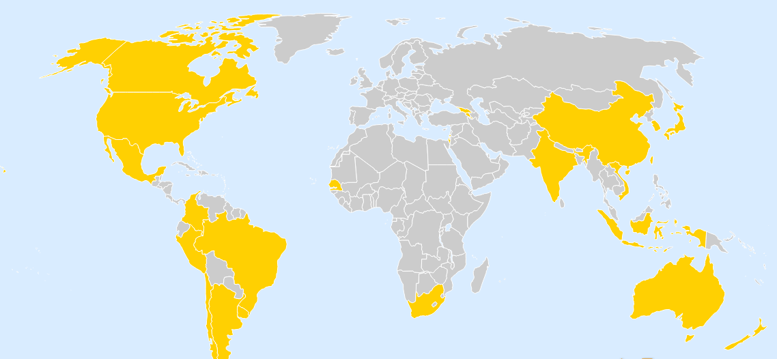
Where can you go?

Slide 19






Some of our partner Universities

Slide 20
When can you leave?
Mobility can last one semester or one academic year
Exchange periods cannot be extended in the Overseas programme
Students who have already been on exchange before with the Overseas programme may apply again, but not for the same partner university

Slide 21
When to apply?
October
Pubblication of a new Overseas Call for applications
Mid-November
Deadline for submitting the applications
December/
January
Pubblication of the results of the selection

Slide 22
Financial Support
All exchange students will receive financial support from the University of Bologna.
The amount of the grant will be established on the basis of the student’s ISEE.

Slide 23
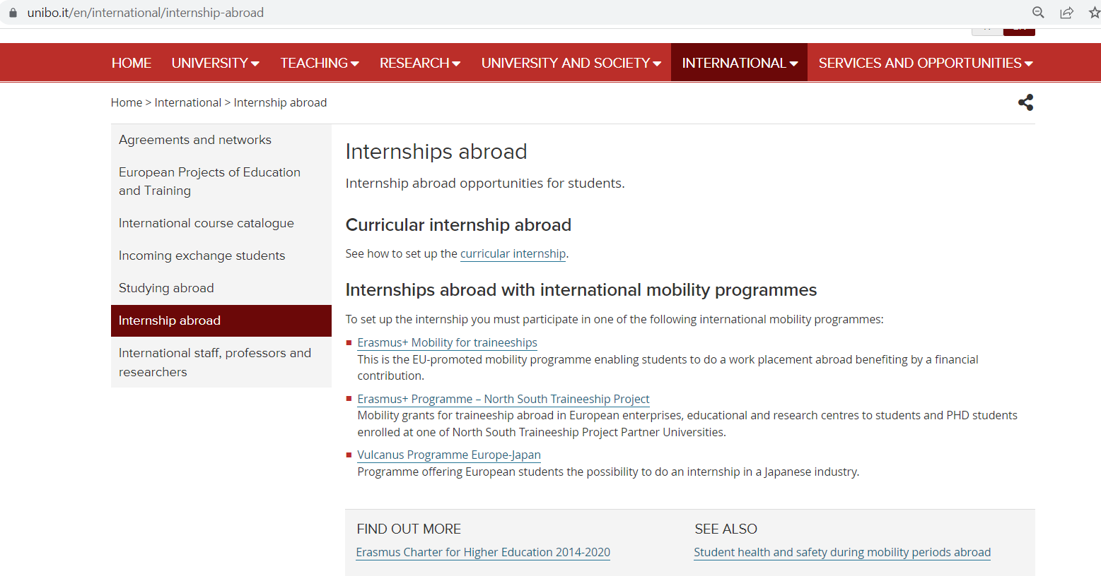
Other academic experiences abroad
a mobility program promoted by the European Union allowing you to spend a period of professional traineeship abroad
https://www.unibo.it/en/international/internship-abroad

Slide 24
Thank you for your attention!
For information about exchanges in the Eastern Neighbouring Countries, Asia, Oceania, North America and Russia
diri.area2@unibo.it
For information about exchanges in Latin America, Africa and the Mediterrean Region
diri.area3@unibo.it

